Slide 1


P.A.R.C.E.L.
Payload Autonomous Robot for Coordination, Expedition, and Logistics
Group 24
Riley Newport, CpE
Melyia Ince-Ingram, CpE
Brandon Zabawa, CpE
Ibrahim Khater, EE

Slide 2
Contents
Meet the Team
Hardware Design
Motivation and Background
Software Design
Goals and Objectives
Prototyping and Testing
Engineering Specifications
Administrative Content and Plans
Comparison and Selection of Hardware and Software
01
06
02
07
03
08
04
09
05

Slide 3




Meet the Team
Riley Newport
Melyia Ince-Ingram
Brandon Zabawa
Ibrahim Khater
Computer Engineering
Computer Engineering
Computer Engineering
Electrical Engineering

Slide 4
Motivation and Background
Advanced robotics, artificial intelligence, and other complex technologies are quickly becoming essential in making factories more efficient and flexible.
Autonomous robots now play key roles in logistics, healthcare, manufacturing, and e-commerce, boosting efficiency, reliability, and cost savings.
This project aims to bridge these gaps, providing a flexible, cost-effective, and efficient system tailored for small and large-scale factory use.
The project integrates hardware and software to enable efficient autonomy using
  Radio Frequency Identification (RFID) systems for object identification
  Ultrasonic sensors for object detection and avoidance
  A two wheel differential drive system
  Visual SLAM for path planning and navigation
  App integration for monitoring
Notes:
Advanced robotics, artificial intelligence, and other emerging technologies are rapidly transforming industries. They’re making factories more efficient, more flexible, and more reliable.
In particular, autonomous robots are already playing a big role in logistics, healthcare, manufacturing, and e-commerce. They help boost efficiency, improve consistency, and reduce costs.
However, many existing solutions are either too expensive or not adaptable enough for small and mid-scale operations. That’s where PARCEL comes in.
Our goal is to design a flexible, cost-effective, and efficient autonomous system that can be used across different factory settings.
To achieve this, we combine both hardware and software solutions to create a system thats practical, scalable, and tailored to real world applications

Slide 5

Goals and Objectives
Basic Goals: The robot is able to safely transport payloads from one location to another and return to its home location while avoiding obstacles. Design a mobile application for the user to view the robot’s status and indicate target location.
Advanced Goals: The robot is able to detect if a payload is on top of it and identify the payload correctly. The robot is able to create a new path to the target location if the original path is blocked.
Objectives
Payload detection: Photoresistor to confirm when items are loaded or removed.
Payload identification: Short-range HF RFID sensor to track and differentiate payloads.
Obstacle avoidance: Distance sensor array to detect objects and reroute paths.
Navigation: API/mapping toolbox on Raspberry Pi for autonomous path planning.
User interaction: Mobile app for delivery location selection and monitoring.

Slide 6
Engineering Specifications
Parameter | Specification
System Specifications
Arrival Distance from Destination | < 1m of its destination
Object Avoidance | Detects objects < 1m
Payload Identification Accuracy | > 90%
Payload Detection | > 90%
Payload Capacity | At least 5 kg
Movement Speed | At least 20 cm/s
App Response Time | At most 10 seconds
Parameter | Specification
System Specifications
Cost | Less than $1000
Dimensions | 60cm x 60cm x 16cm

Slide 7
Comparison and Selection of Hardware -
Payload Identification
Barcodes/QR Codes vs. RFID
Barcodes/QR Codes | RFID
Direct line of sight | Without direct line of sight and through objects
Closer proximity | Farther proximity
Data is read only | Data is read and write
Only identify the type of item | Can uniquely identify each item tagged
Read only one at at time | Read multiple tags simultaneously
Read time > 500ms per tag | Read time is < 100ms per tag
More subject to wear on payload | Less subject to wear on payload
Less costly than RFID | More costly than Barcodes/QR Codes
Notes:
TALKING NOTES:
I’ll start off our comparison and selection of hardware with the payload identification
I compared Barcodes/QR to RFID codes and determined the only real benefit to Barcodes/QR codes would have been reduced cost
The Benefits of RFID are
That data is read and write so payload info can be updated
It allows for items to be uniquely identified instead of only the type of items

Slide 8
Comparison and Selection of Hardware -
Payload Identification
Types of RFID Tags
Passive | Semi Passive | Active
Components: Integrated Circuit, Antenna | Components: Integrated Circuit, Antenna, Battery | Components: integrated circuit, antenna, battery, on-board transmitter
Receives power from the reader through inductive coupling | Powers its circuitry and processing capabilities, still relying on the reader to activate and transmit data | transmitter sends energy directly to the reader
Shortest range | Medium range | Longest range
Small size | Small size | Larger size
Typically least expensive | Medium price | Most expensive
Longest lifespan | Medium lifespan | Shortest lifespan
Notes:
TALKING NOTES:
After selecting RFID technology it's important to discuss the different types.
RFID will include two parts: The RFID reader module on the robot and the RFID tag that will attach to the payloads
The RFID tags come in 3 types:
Passive, semi-passive, and active which all have progressively longer read ranges
We choose passive because they are lowest cost and longest lifespan and we just don’t need a longer range
Passive has no battery of its own and power only comes from the reader module through inductive coupling (shortest range: a couple of inches to a couple of feet)
Semi-passive which has battery but still relies on the reader to activate and transmit data (medium range: 30-100ft)
Active which has an on-board transmitter and is able to continuously transmit signals (longest range: up to 300+ ft)

Slide 9
Comparison and Selection of Hardware -
Payload Identification
Frequency of Passive Tags
Low Frequency | High Frequency | Ultra High Frequency
Available in 125kHz, 134kHz | Available in 13.56 MHz | Available in 860–960 MHz
near-field inductive coupling | near-field inductive coupling | far-field radiative coupling also known as backscatter coupling
read range of a few inches | Read range less than 3 feet | Read range of 15 to 20 feet
lowest data transfer rate | Medium data transfer rate | Highest data transfer rate
No anti-collision → can’t read multiple simultaneously | Some have anti-collision, most do not have anti-collision | All have anti-collision → allowing multiple tags to be read simultaneously
expensive to manufacture | lower in cost than LF tags due to simpler antenna design | UHF readers are more expensive than HF readers
Notes:
TALKING NOTES:
Passive Tags can be LF, HF, or UHF
We didn’t choose LF because it is the most expensive with the lowest data transfer rate
We choose HF because HF tags offer a more reliable and less complex solution thant UHF
UHF have much more expensive reader modules and we don’t need a range a range of 15-20 fit the HF range of up to 3 feet will do fine

Slide 10
Comparison and Selection of Hardware -
Payload Identification
High Frequency RFID Reader Modules
CN0090 [C.4] | RYRR10S [C.5] | RYRR20I_DE [C.6] | Pepper C1 Module [C.7] | RC522 [C.40]
Read Only | Read Only | Read Only | Read/Write | Read/Write
Tags: ISO14443a | Tags: ISO15693, ISO14443A, ISO14443B | Tags: ISO14443A ISO14443B, , ISO15693, FeliCa, ISO18092 | Tags: ISO14443A, ISO15693 | Tags: ISO/IEC 14443 A/MIFARE and NTAG
Range: few cms | Range: 4cm to 8cm | Range: 4cm | Range: up to a meter | Range: a few cms
Communication Protocols: I2C, Serial UART, SPI | Communication Protocols: UART, SPI | Communication Protocols: UART | Communication: UART, Wi-Fi | Communication: SPI, UART, I2C
$5.60 | $6.00 | $15.00 | $32.14 | $6.99
Notes:
TALKING Notes:
The RFID module we choose is the RC522 which will allow us to read and write. Our main reason for choosing this one specifically was because we already had one on hand.

Slide 11
Comparison and Selection of Hardware -
Distance Sensor
Ultrasonic vs. Optical TOF vs. LiDAR
Ultrasonic | Optical TOF | LiDAR
Less accurate with objects that absorb sound waves | Independent of object material | Independent of object material
Independent of target colors and reflectivity | Possibly can be affected by target colors and reflectivity | Better performance than optical TOF but can still be affected by target colors and reflectivity
Ambient immune | Ambient interference | Ambient interference, FMCW is ambient immune
few cm to several meters | few mm to several meters | several meters to hundreds of meters
Slower response time | Fast response time | Fastest response time
Moderate accuracy | High accuracy | Highest accuracy
Low power consumption | Low power consumption | Usually higher power consumption than Ultrasonic and TOF
Least expensive | More expensive by a little | Most expensive and by a large margin
Notes:
TALKING NOTES:
For the distance sensor I compared 3 types of sensors
Originally choose optical tof because its accuracy is independent of object material unlike ultrasonic sensors, faster + more accurate
Had to switch to ultrasonic because tof sensors have pins on the bottom and Dr. Weeks doesn’t want us soldering pins on the bottom
We are using ultrasonic sensors now and we are going to use more of them to compensate for the reduced accuracy

Slide 12
Comparison and Selection of Hardware -
Distance Sensor
Ultrasonic Sensor Models
HC-SR04 [C.41] | I2CXL-MaxSonar-EZ [C.42]
Range: 2cm-400cm ± 3mm | Range: 0m to 7.65m
Operating Voltage: 3V-5.5V | Operating Voltage: 3V-5.5V
Frequency : 40KHz | Frequency: 42KHz
Communication: simple digital pin signals | Communication: I2C bus communication
$5.44 | $39.95
Notes:
TALKING NOTES:
For the ultrasonic sensor model we choose the HC-SR04 because it is the mostly widely available and cheapest option.

Slide 13
Comparison and Selection of Hardware - Single Board Computer
Single Board Computers
Specifications | Raspberry Pi 5 | Raspberry Pi 4B | Nvidia Jetson Nano | Arduino Mega
CPU | 2.4GHz quad-core 64-bit Arm Cortex-A76 CPU | Quad-core Cortex-A72 at 1.5GHz | ARM Cortex -A57 MPCore (Quad-Core) | Quad-core ARM Cortex-A57 at 1.43GHz
RAM | 8GB LPDDR4X SDRAM | 8GB LPDDR4 | 4GB at 1600MHz LPDDR4 | 8KB SRAM
Wireless Connectivity | Dual-band 802.11ac Wi-Fi,Bluetooth 5.0 / Bluetooth Low Energy (BLE) | 2.4- 5.0 GHz IEEE 802.11b/g/n/ac wireless LAN, Bluetooth 5.0 | No WiFi | No WiFi/Bluetooth
Input Power | 5V/5A DC power via USB-Ct | 5V/3A DC via USB-C connector and GPIO | 5.0V DC input | 5V/200mA DC Input
GPIO | Standard 40-pin header | Standard 40-pin GPIO header | Standard 40-pin GPIO header | 54 digital I/O pins
Communication | Same as Raspberry Pi 4 | 1 bus I2C,SPI, 1 UART | 4 ports UART,SPI,I2C | GPIO UART,SPI, I2C
GPU | VideoCore VII GPU | VideoCore VI | 128-core GPU | None
Software Support | Linux, ROS2, OpenCV, | Linux, ROS2, OpenCV | Linux, AI-based CUDA acceleration | Arduino

Slide 14
Comparison and Selection of Hardware - Cameras
Visual Sensors
Specification | Raspberry Pi V2 | Arducam 2MP | Arducam 12MP
Sensor Model | Sony IMX219 | Sony IMX462 | Sony IMX708
Shutter Type | Rolling Shutter | Rolling Shutter | Rolling Shutter
Focus Type | Adjustable Focus | Manual Focus | Fixed Focus
Resolution | 8 MegaPixels | 2 MegaPixels | 12 MegaPixels
Video Quality | 1080p47, 1640 × 1232p41 and 640 × 480p206 | 1920 × 1080 | 4608 x 2592
Pixel Size | 1.12 µm × 1.12 µm | 2.9 µm × 2.9 µm | 1.4µm x 1.4µm
Frame Rate | Up to 30 fps (1080p) | Up to 60fps(1080p) | Up to 60fps, lower at higher resolutions
Field of View | 62.2°x 48.8° | 161°x141.4°x81.7° | 120°x 102°x 67°
IR Sensitivity | NoIR variant, also works for low-light environments | Integral IR-cut Filter, visible light only | Integral IR-cut Filter, visible light only
Cost | $15.00 | $35.99 | $39.49

Slide 15
Comparison and Selection of Hardware - Inertial Measurement Unit
Feature | 6-Axis IMU | 9-Axis IMU
Sensors | 3-axis gyroscope, 3-axis accelerometer | 3-axis gyroscope, 3-axis accelerometer, 3-axis magnetometer
Complexity | Low | Moderate
Susceptibility to Interference | Low | High
Power Consumption | Low | Moderate
Cost | Low | Moderate
Feature | IIM-20670 | ICM-42688 | LSM6DSO
Comm. Interface | SPI | I2C/I3C/SPI | I2C/I3C/SPI
Power Consumption | Low | Moderate | Low
Noise | Low | Low | Low
Accelerometer Range (g) | ±2 to ±65 | ±2 to ±16 | ±2 to ±16
Gyroscope Range (dps) | ±41 to ±1966 | ±15.625 to ±2000 | ±125 to ±2000
Cost | Moderate | Low | Low
Notes:
An IMU will be used to provide motion tracking data. IMUs can be classified by the number of axes: 3, 6, or 9.
3 immediately eliminated as it fails to provide enough data for tracking. 6 and 9 axis are then compared. While a 9 axis could provide the robot with more heading info and more accurate movement, the robot primarily relies on the algorithm and various sensors for localization. Introducing a magnetometer comes with more complexities and is more susceptible to noise. thus the magnetometer on a 9 axis IMU is unnecessary.
Comparing different 6 axis IMUs, we decided that the IIM-20670 is the best option. With a low power consumption and easily solderable IC package, the IIM is easy to integrate and work with on our system.

Slide 16
Comparison and Selection of Hardware - Microcontroller
Microcontroller | Processing Speed | Power Consumption | Communication Interfaces | Cost
ESP32-WROOM-32E | 240 MHz | Medium (3-3.6 V, 0.5 A) | UART, SPI, I2C, Wi-Fi, Bluetooth | Low
STM32F103C8T6 | 72 MHz | Low (2-3.6 V, ~50mA) | I2C, USART, SPI, CAN, USB | Moderate
ATmega328p | 16 MHz | Low (2.7-5.5 V, ~20mA) | USART, SPI, I2C | Low
PIC18F45K22 | 64 MHz | Very low (2.7-5.5 V, ~10mA) | EUSART, SPI, I2C | Low
Notes:
The MCU is a crucial part of the system. It will serve as core unit for handling all of the control tasks and take in most of the sensor data in real time. It needs to support multiple different communication protocols to interface with all the sensors and the raspberry pi. Processing power is another major factor as the MCU should be able to handle a variety of sensor inputs as well as motor control without significant delays.
The functionalities of the MCU are also crucial. For example, in order to properly control the motors the MCU must be able to produce a stable PWM signal. The selected MCU must have all of this as well as abundant GPIO pins available and be cost effective. With all of this in mind, the ESP32 series emerges as the most suitable option for this project. It’s a low cost MCU that meets all of the minimum criteria and has built-in WiFi and Bluetooth capabilities.

Slide 17
Comparison and Selection of Hardware - I/O Expander
Specification | TCA9554PWR | MCP23S17 | PCA9555
Interface | I2C/SMBus | SPI | I2C/SMBus
Voltage (V) | 1.65-5.5 | 1.8-5.5 | 2.3-5.5
I/O Count | 8 | 16 | 16
Interrupt | Yes | Yes | Yes
Notes:
In order to ensure that there are enough GPIOs for the peripherals, an IO expander is needed. The IO expander will be minimal and handle a number of extra components to ensure full functionality of the system. The expander will need to support I2C communication as SPI is already being used by the IMU. for this project, the TCA9554 was selected as it is more compact and fulfills the minimum requirements for the while providing enough additional IOs.

Slide 18
Comparison and Selection of Hardware - Motor Type
Motor Type | Torque | Power Consumption | Control Precision | Control Complexity | Cost
Brushed DC Motor | High | High | Medium | Low | Low
Brushless DC Motor | High | Low | High | High | High
Stepper Motor | High | High | High | Moderate | Low
Servo Motor | High | Moderate | High | Moderate | Moderate-High
Notes:
The robot will be driven with two motors. They need to provide the necessary torque and speed to move the robot while also ensuring simplicity and precise control. The mcu must be able to fine tune the motors and ensure the robot is moving at a constant speed and as desired. Power consumption and cost are also very important criteria to consider. After evaluating different types of motors, brushed DC motors were selected due to their ideal balance: theyre simple to use, cost effective, and easy to control through PWM.

Slide 19
Comparison and Selection of Hardware - Motor
Motor | Voltage (V) | Current (A) | Torque (Nm) | Speed (RPM) | Weight (g) | Control Feedback | Cost ($)
24PG-2430BL-1260-256 | 12 | 0.5-1.9 | 1-3 | 18.5-23 | NA | None | 19.69
Pololu 2828 | 12 | 0.2-5.5 | 0.5-5 | 67 | 210 | Encoder | 51.95
638266 | 12 | 0.54-1.2 | 2-4 | 20-26 | 380 | None | 39.99
Notes:
After determining that a brushed DC motor would be used, different specific models were compared. Analyzing the criteria and features of each motor led us to the decision of using the Pololu 2828. While its a bit on the higher end in terms of cost, it provides sufficient torque and speed. It comes integrated with an encoder that will allow us to more accurately control the motors individually through the MCU.

Slide 20
Comparison and Selection of Hardware - Motor Driver
Specification | TB9051FTG | VNH5019 | DRV8871 | MC33926
Input Voltage (V) | 4.5-28 | 5.5-24 | 6.5-45 | 5-28
Output Current (A) | 5 | 30 | 4 | 5
Protection Features | Overcurrent, Overvoltage, Thermal Shutdown | Overcurrent, Overvoltage, Thermal Shutdown | Thermal Shutdown | Overcurrent, Thermal Shutdown
Control Interface | PWM + DIR | PWM + DIR | PWM | PWM + DIR
Price | Moderate | Moderate | Low | Moderate
Notes:
An H bridge motor driver is needed to control the motor’s speed and direction. The robot must be able to go forwards and backwards as well as change speeds easily. Our motors have a maximum current draw of 5A so the driver’s output must be higher than that. Therefore, the best option is the VNH5019. It provides both speed and directional control via PWM and digital IOs respectively and boasts a maximum output current of 30A, well over our needed maximum. It also provides built-in overcurrent, overvoltage, and thermal shutdown protection.

Slide 21
Comparison and Selection of Hardware - Power Supply
Feature | Lithium-Ion | LiPo | NiCd | NiMH | Lead Acid
Specific Energy (Wh/kg) | 150-200 | 140-200 | 40-60 | 60-120 | 30-40
Self-Discharge Rate (%/month) | 5-10 | 5-10 | 20 | 30 | 3-20
Memory Effect | No | No | Yes | Yes | No
Weight | Light | Very Light | Heavy | Medium | Heavy
Cost | $75+ | $150+ | $100+ | $150+ | $20-30
Advantages | High energy density, low self-discharge, no memory effect | High energy density, low self-discharge, no memory effect, small and thin | Long life cycle | Inexpensive | High surge currents, very low cost, easy to use, low self-discharge
Disadvantages | Expensive, can overheat, safety concerns | Expensive, can overheat, safety concerns | Requires frequent discharging, heavy | Low capacity, high self- discharge, toxic materials | Low energy-to- weight ratio, corrosion, heavy
Notes:
The robot and all peripherals must be sufficiently powered while also maintaining portability. For this reason, different types of batteries were compared. Taking into account the motors and the rest of the system, a 12V battery would be ideal. The different battery types considered are lithium ion, lipo, nicd, nimh, and lead acid. Each type offers distinct advantages and disadvantages. Lithium ion and lipo batteries provide high energy density and are lightweight, but come with high costs, safety risks, and are more complex to integrate. NiCd and NiMH, while offering good durability, have a lower energy density and suffer from memory effect, leading to lower capacity over time. Lead acid batteries, despite being heavier than the other options, emerge as the most suitable choice due to their combination of safety, reliability, cost effectiveness, and ease of maintenance. Considering all of this, lead acid batteries were selected for this project.

Slide 22
Comparison and Selection of Hardware - Voltage Regulators
3.3V Buck Regulator (LM2576-3.3) | 5V Buck Regulator (LM2576-5.0) | 5.2V Buck Regulator (LM2679SX-ADJ)
ESP32 Motor Drivers RFID IMU GPIO Expander | Motor Encoders Ultrasonic Sensors | Raspberry Pi 5
Notes:
Three different voltage regulator circuits will be used.
A fixed LM2576 at 3.3V that will handle the bulk of the power distribution, going to the ESP, motor drivers, RFID module, IMU, and the GPIO expander
another fixed LM2576 at 5V will be distributed to the motor driver boards to power the encoders, and to the ultrasonic sensors
An adjustable LM2679 set to 5.2V is reserved specifically for the raspberry pi. We’re using an adjustable version rather than a fixed to account for the voltage drop and ensure the raspberry pi is getting sufficient voltage to operate.

Slide 23
Comparison and Selection of Software - Mobile
App
Feature | Flutter | React Native | Python
Platform Capability | IOS/Android | IOS/Android | iOS/Android
Programming Language | Dart | Javascript | Flask
UI Implementation | Wide amount of widgets, consistent across platforms | Uses CPU and GPU acceleration with MATLAB’s parallel computing | Flexible Micro-web framework to create websites on all platforms.
Robot Integration | Easy integration via plugins or custom channels | Limited SLAM support, only for static images | Focus is on creating APIs/Sockets for network communications that can work with ROS by acting as the Middleman
User Complexity | Moderate Ease of Use | User-friendly scripts and intuitive | Low-Moderate (depends on level of experience)
Efficiency | High efficiency on standard hardware | Generally slower computation time | Variable (Flasks pros become cons as applications complexity grows).

Slide 24
Comparison and Selection of Software - Connectivity
Image of Speaker
WiFi vs Bluetooth
WiFi |  | Bluetooth
Consumes lots of Power |  | Consumes low amounts of Power, Great for Small or general battery-powered devices.
Free of charge and extends farther with local network connections (LAN) or to the internet. |  | Expensive for top-line products with great range, but options for a cost affordable option
Indoor & Outdoor range |  | Limited range (100 meters)
More users can connect to WiFi |  | Limited amount of users that connect to device
Large frequency band (2.4-5 GHz) |  | Low Frequency (2.4GHz) that has interference issues with other devices
Faster Speed: Data Transfer for WiFi 6 is 9.6GBps |  | Slower Speed: 50MBPS with Bluetooth 5.0
Greater security: WPA2 and WPA3 |  | Bad Security: Attack prone for low-end Bluetooth devices.
Faster Bit-rate speed: 600MBPS |  | Slower Bit-rate speed: 2.1MBPS

Slide 25
Comparison and Selection of Software - Communications
TCP vs UDP
TCP |  | UDP
Manages the transfer of data in a set sequence between sender & receiver via measures like the 3-Way Handshake. |  | Has standard messager protocol between sender and receiver. Nothing special and is why it is not very secure either unlike TCP.
Operations are independent on Operating System (OS) |  | Performs own operations independently on the Operating System (OS).
More protocols like recovery protocols, security protocols taken to handle network packets |  | Low amounts of recovery protocols to ensure throughput is maintained.
TCP vs UDP
TCP |  | UDP
Has the ability to SSH (Secure Shell) into something via remote administration. This is great for remote SSHing into Pi, and continuing working on it from different locations. |  | Does not support UDP connections directly. Need additional tools to make this process work.
Can reduce speed of data based on receivers speed. |  | Does not reduce speed to sacrifice performance, however does lose packets causing lower accuracy.

Slide 26
Comparison and Selection of Software - SLAM Protocols
Features | Visual SLAM | LiDAR SLAM
Technology Used | Visual sensors (Monocular, Stereo, RGB-D cameras) | LiDAR sensors (Laser based sensors)
Cost | Moderate | Moderate
Power Consumption | Low (Cameras use less power) | High
Computational Load | High (including feature and frame processing) | Medium (point cloud processing)
Mapping Accuracy | Good but affected by lighting | High
Obstacle Detection | Moderate | High
Environment Conditions | Affected by lighting and visual obstructions | Not affected by conditions

Slide 27
Comparison and Selection of Software - Visual
SLAM
Feature | ORB-SLAM | RTAB-Map
Algorithm | Feature-based SLAM | Graph-based SLAM
Sensors Required | Works with Monocular, Stereo, and RGB-D cameras | Primarily used with RGB-D,stereo cameras and LiDAR
Mapping Type | Sparse point-based 3D map | 3D point cloud and occupancy grid maps
Loop Closure Method | Bag-of-words approach | Appearance-based loop closure for relocalization
Real-Time Capability | Ideal for real-time tracking and feature extraction | Excellent Real-time tracking but with high hardware demand
Computational Load | Moderate efficiency | Highly Intensive
Use Cases | Indoor/outdoor navigation, object tracking and localization | Large-scale mapping, multi-session SLAM, long-term environment tracking
Cost | Relatively Cheap (depending on hardware) | Expensive

Slide 28
Comparison and Selection of Software - Image Processor
Feature | OpenCV | MATLAB Image Processing Toolbox | Nvidia VisionWorks
Platform Capability | Linux, Raspberry Pi, Windows | Windows,Linux and MacOS | Nvidia Jetson (CUDA enabled)
Programming Language | C++, Java and Python | MATLAB | C++
Hardware Requirements | Relies on CPU processing however can use a GPU as well | Uses CPU and GPU acceleration with MATLAB’s parallel computing | Relies on Nvidia hardware (GPU)
SLAM Capabilities | ORB-SLAM, RTAB-MAP, LiDAR SLAM | Limited SLAM support, only for static images | Compatible with all SLAM by Nvidia’s SDK
Cost | Free/Open-Source | Requires paid license | Free
User Complexity | Moderate Ease of Use | User-friendly scripts and intuitive | High Complexity
Efficiency | High efficiency on standard hardware | Generally slower computation time | High Efficiency optimized with Nvidia GPUs

Slide 29
Comparison and Selection of Software - Path Planning
Path Planning Algorithms (Nav2 slam_toolbox)
Feature | Navfn | DWA
Algorithm Type | A* algorithm | Velocity-space sampling
Use Cases | Navigates large, known environments | Indoor real-time reactive obstacle avoidance
Input | Start & goal pose from SLAM | Current robot pose via SLAM, velocity, local costmap
Planning Type | Global Path Planning | Local Path Planning
Obstacle Avoidance | Avoids known static obstacles in global map | Dynamic obstacle avoidance
Computational Load | Efficient but Slightly higher load | CPU-Accelerated/ Lightweight
Real-Time Function | Runs occasionally, not frequent | Continuously running and scanning
Limitations | Doesn’t account for robot dynamics; static environments | Needs a costmap; poor in congested areas
ROS | Integrated with the nav2 package | Integrated with ROS2’s nav2 package
Ease of Use | Simple setup with Nav2 controller | Works as a package in the Nav2 plugin in ROS2

Slide 30
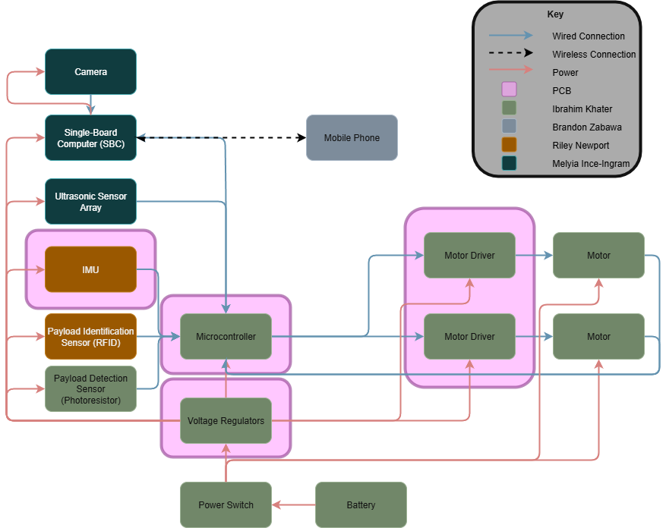
Hardware Design - Overall Block Diagram

Slide 31
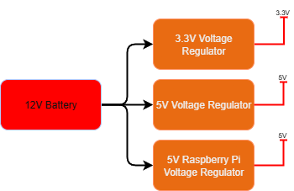
Hardware Design - Power Block Diagram

Slide 32
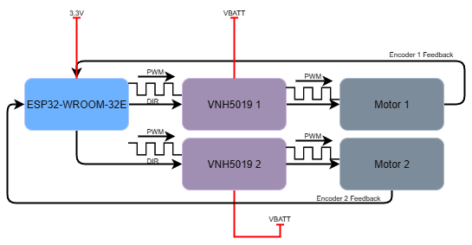
Hardware Design - Motor Controller Block Diagram

Slide 33
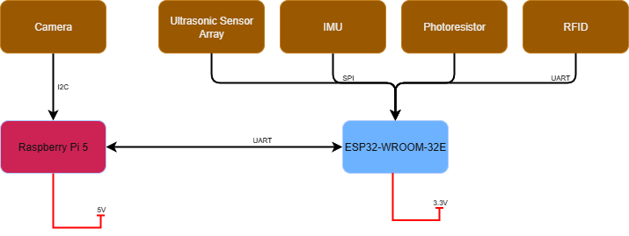
Hardware Design - Sensors Block Diagram

Slide 34
Hardware Design - PCBs
Mainboard
  ESP32 MCU
  IMU
  GPIO Expander
  Connectors for peripherals and external sensors
Power
  3V3 Regulator Board
  5V Regulator Board
  5V2 Raspberry Pi Regulator Board
Motor Controller
  Control speed and direction of motors

Slide 35
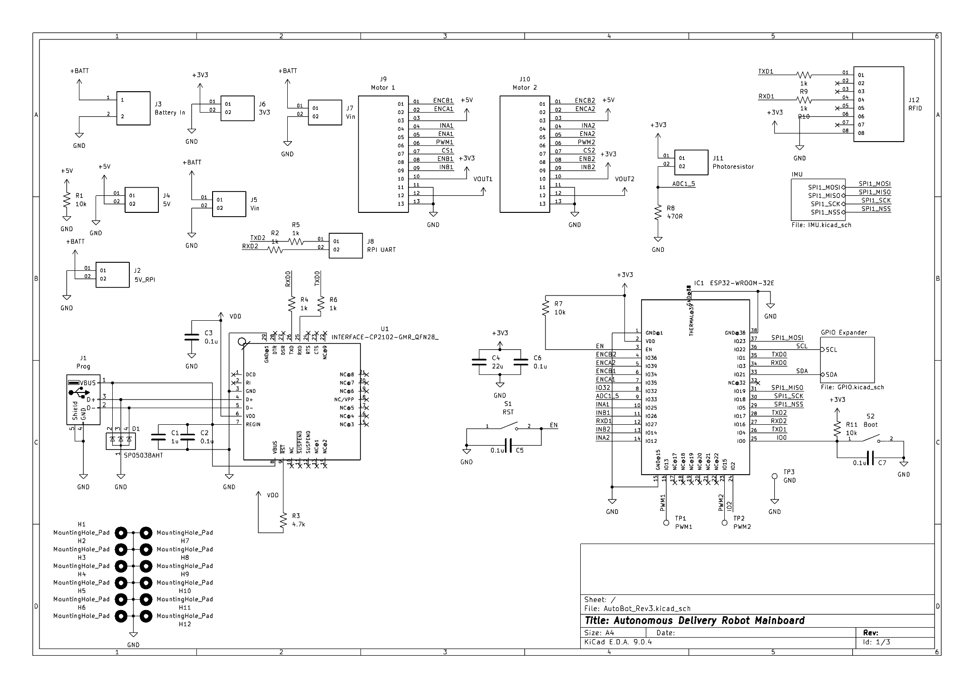
Hardware Design - Mainboard Schematic

Slide 36
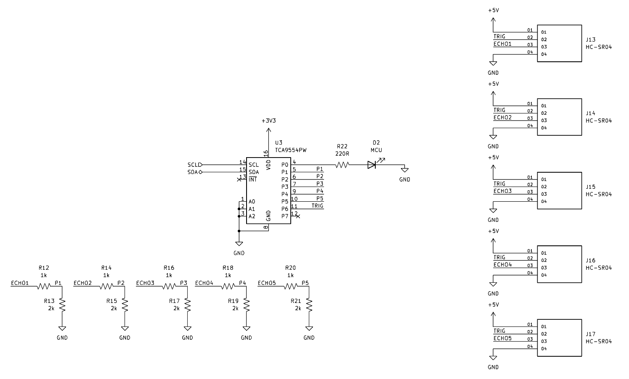
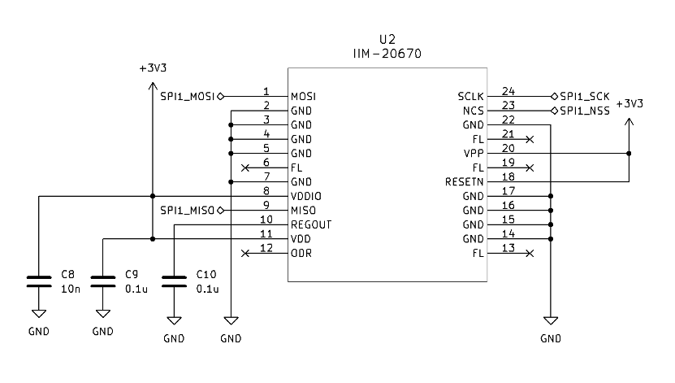
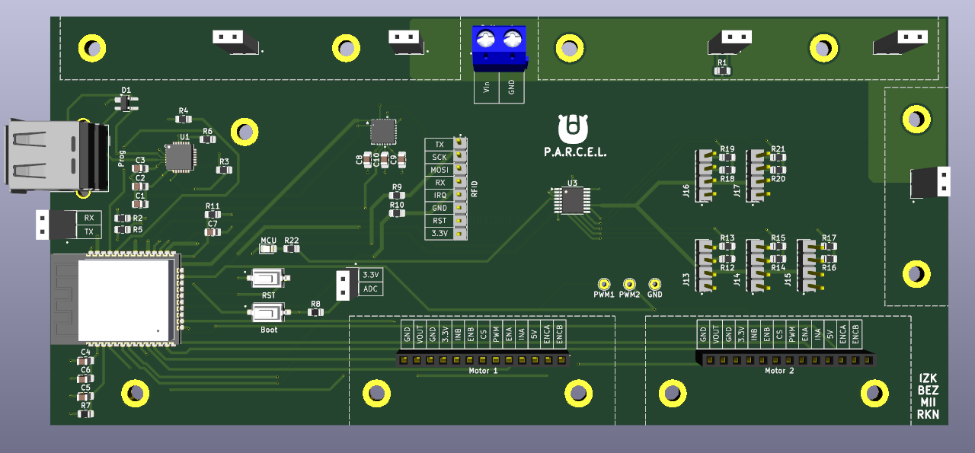
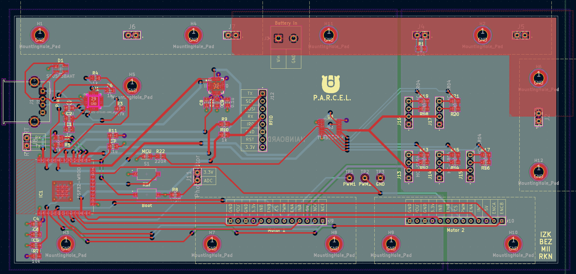
Hardware Design - Mainboard Schematic Cont.

Slide 37
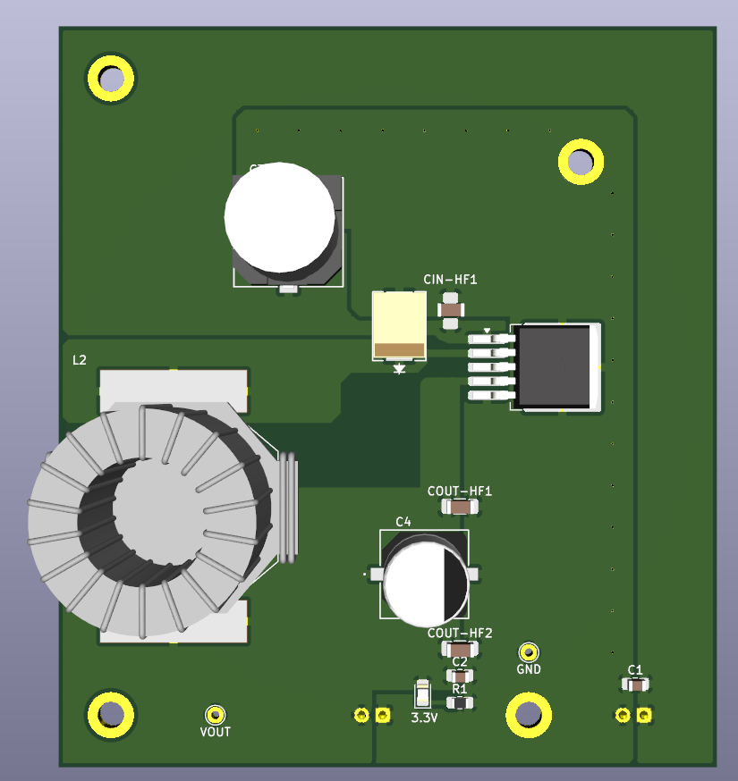
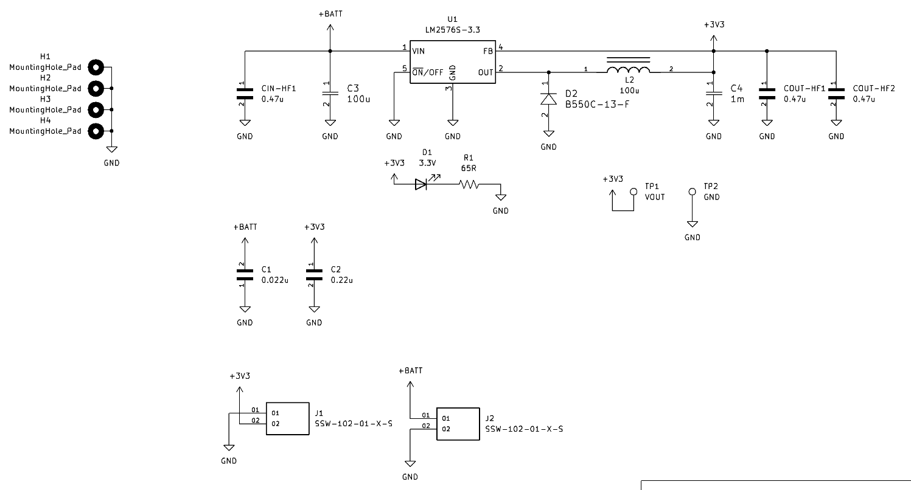
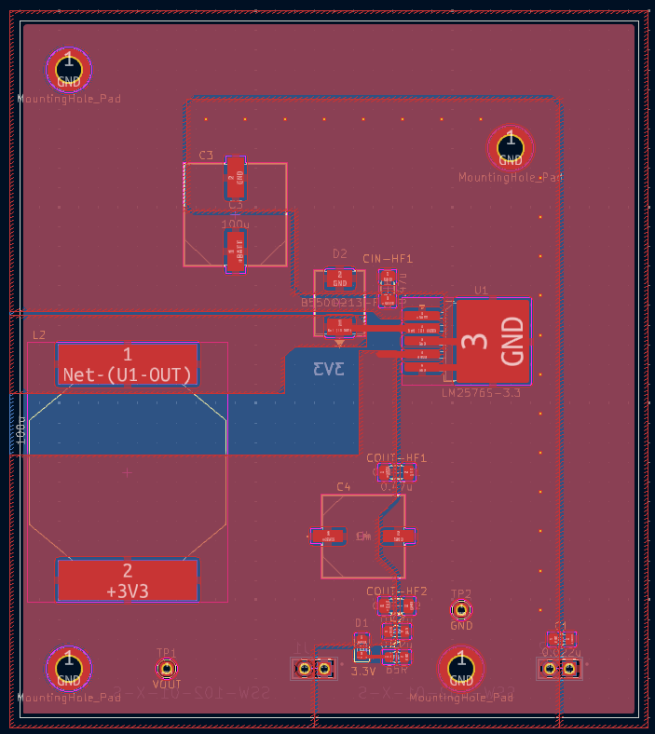
Hardware Design - 3V3 Regulator Schematic

Slide 38
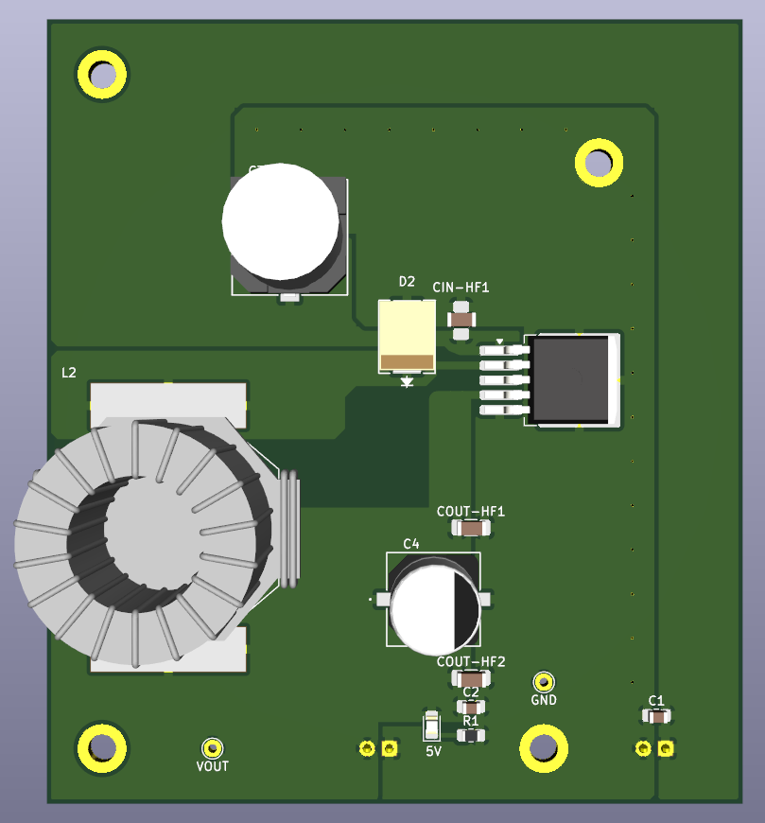
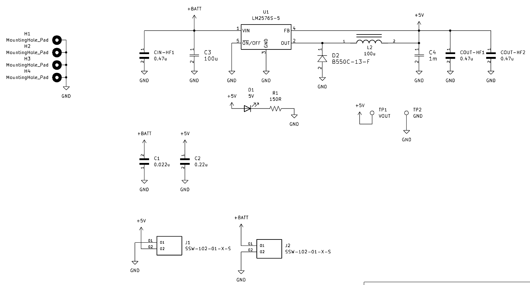
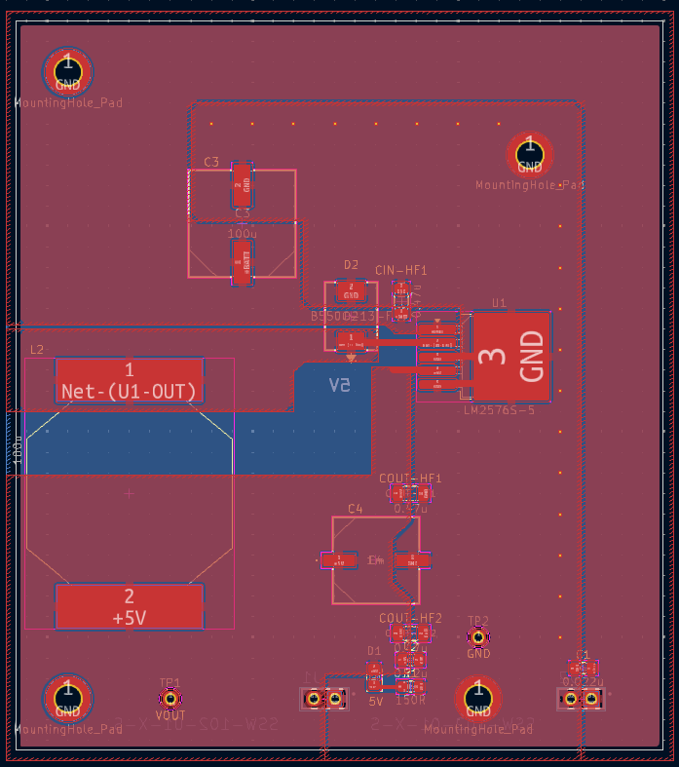
Hardware Design - 5V Regulator Schematic

Slide 39
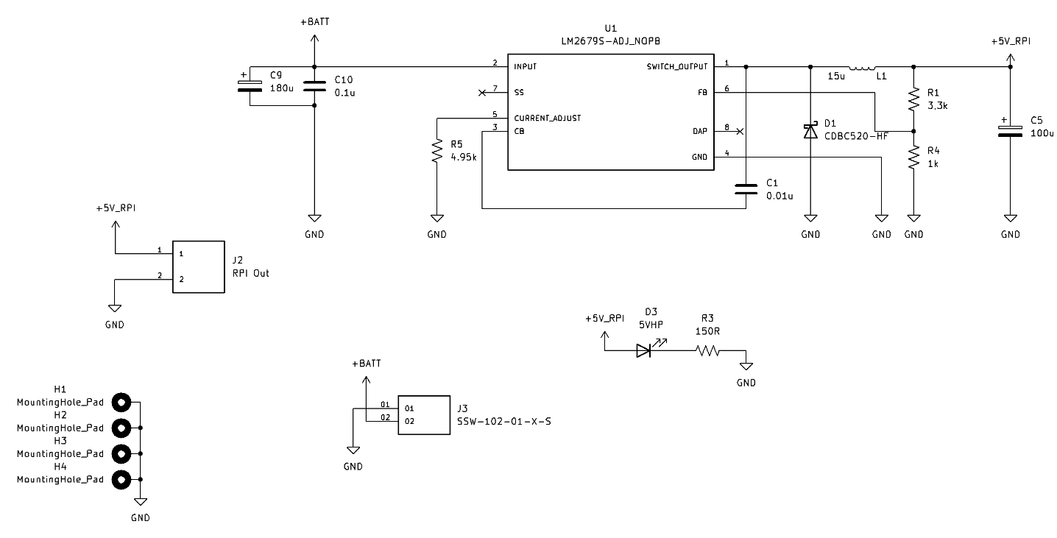
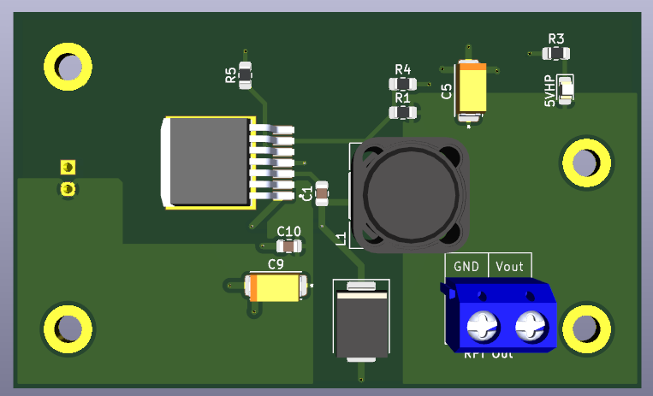
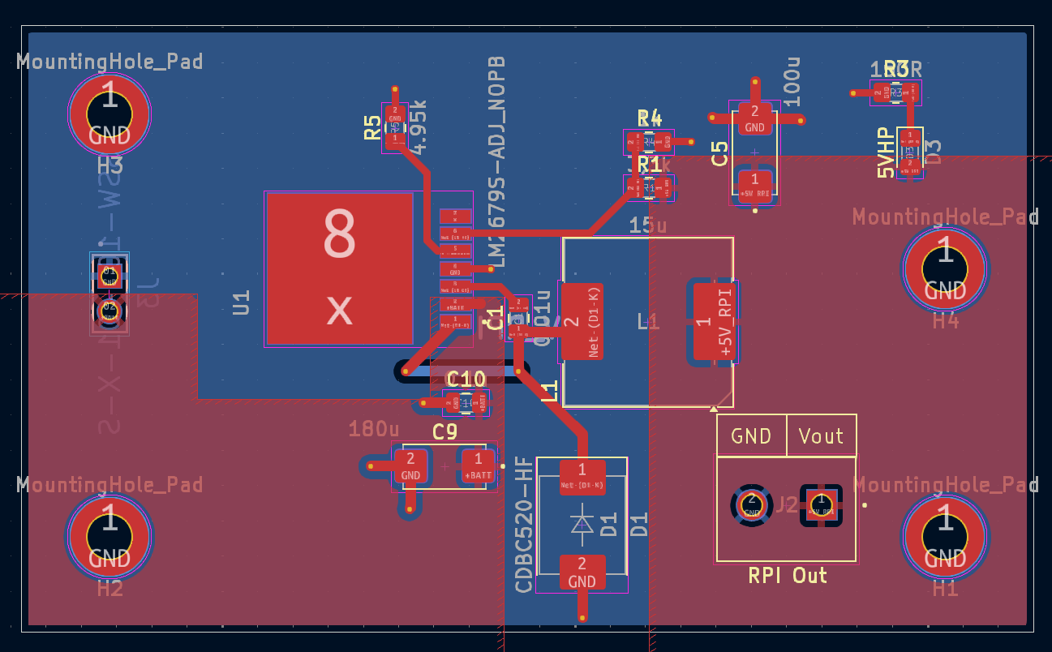
Hardware Design - 5V2 RPI Regulator Schematic

Slide 40
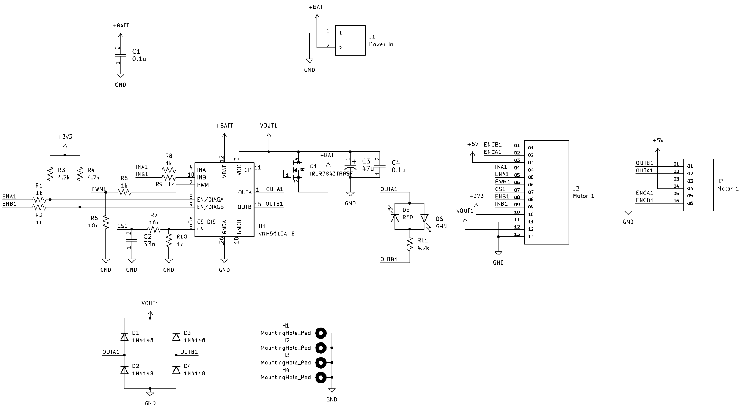
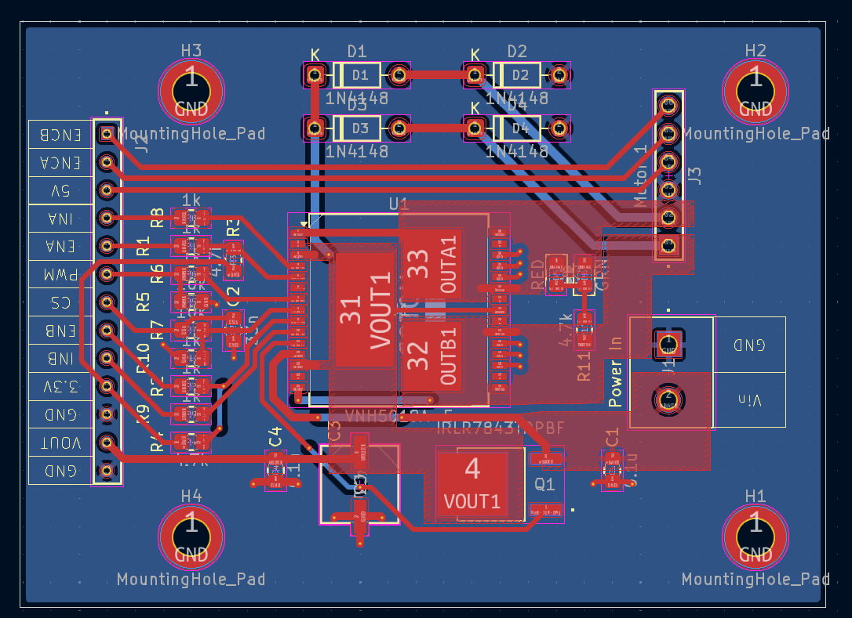
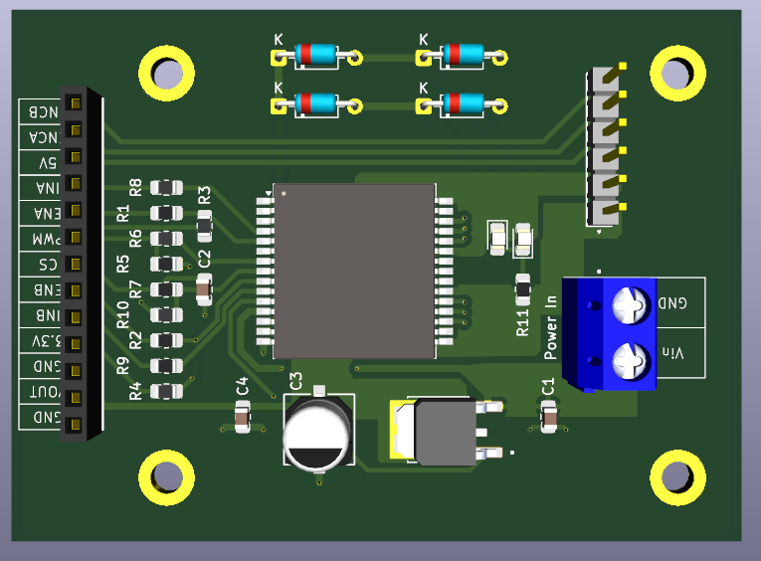
Hardware Design - Motor Controller Schematic

Slide 41
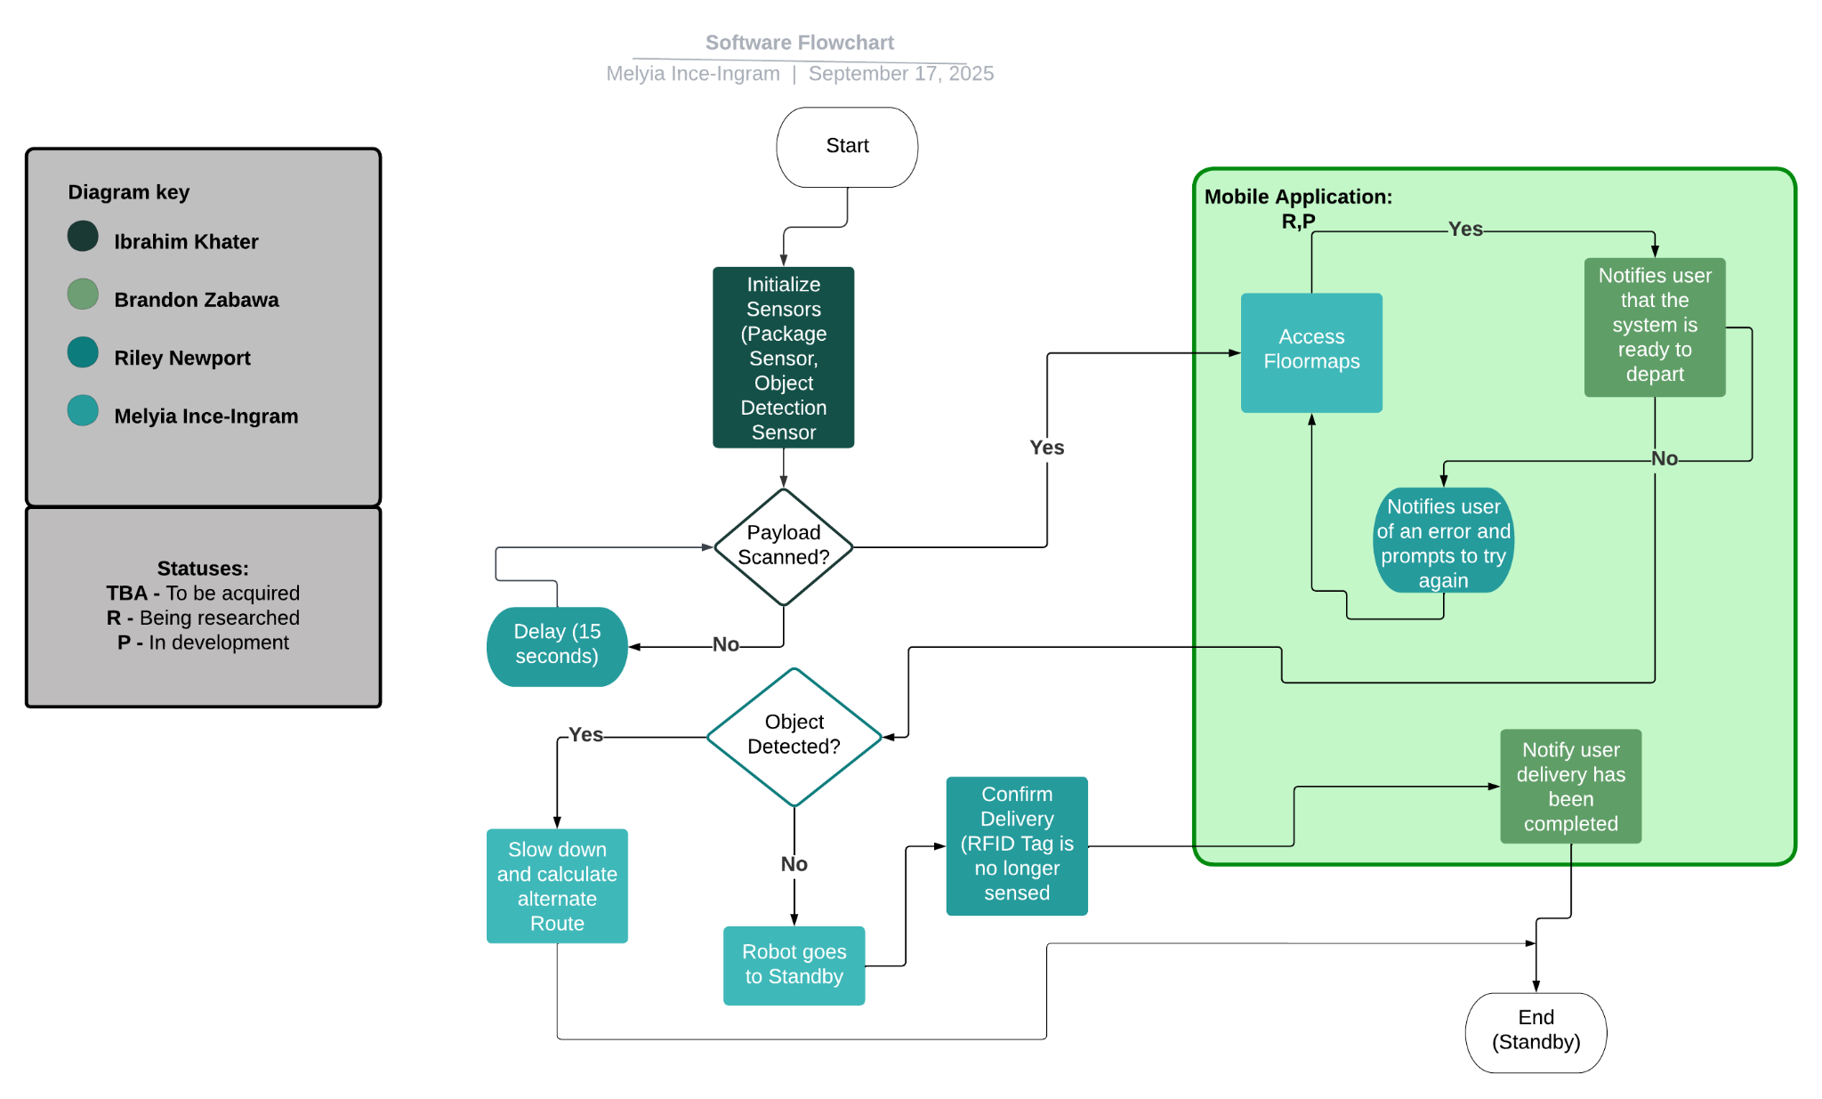
Software Design - Software Flowchart

Slide 42
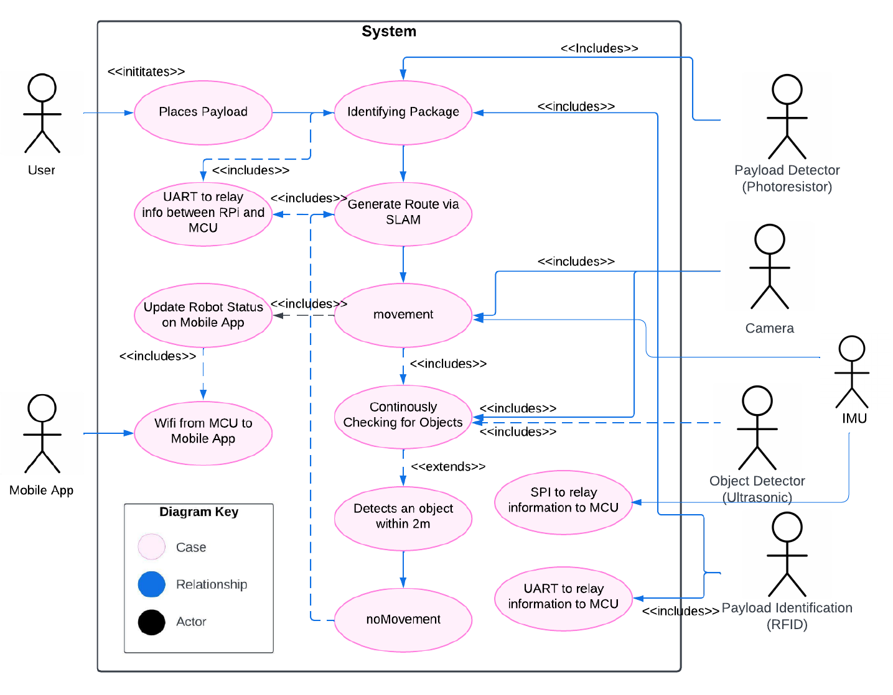
Software Design - Use Case

Slide 43
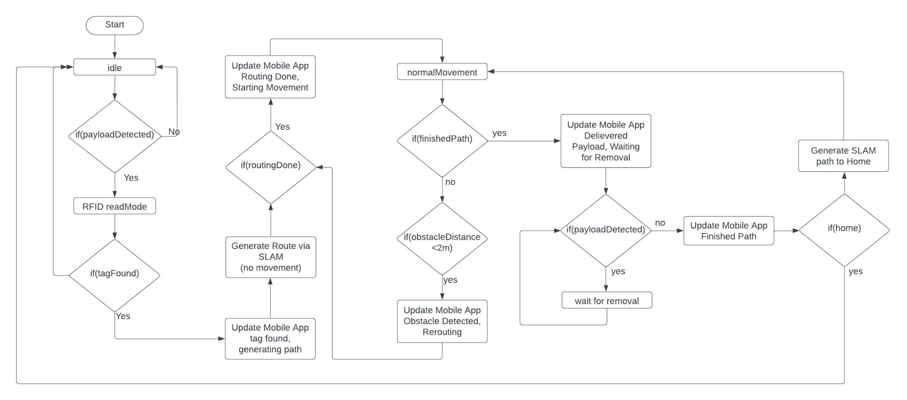
Software Design - State Diagram
Notes:
Here is our state diagram for the microcontroller. After establishing wifi connection to the mobile device, UART connection to the raspberry pi, and initializing our sensors we’ll enter into the normal running mode with the states as shown. We start in the idle state and wait until we detect a payload using the photoresistor. If we detect a payload we move into the RFID read mode. Here, we will wait until an rfid tag is found. If the tag is found then we can update the mobile app and then generate a route with SLAM. once SLAM has routed a path we can begin normal movement. While in the normal movement state we’ll have two threads where one will will read data from the imu and ultrasonic sensors and send this information via uart to the raspberry pi. From there it going into SLAM. the second thread will read controls from SLAM and control the motors: speed, direction, etc. If there is an obstacle detected with the ultrasonic sensors then it will trigger a task with a higher priority and the robot will stop movement and wait to reroute to find a new path to the destination. If we finish the path then we will wait for the payload to be removed. Once removed, we can generate a path to the home location. If this path we followed was a path to home then we can return to the idle state.

Slide 44
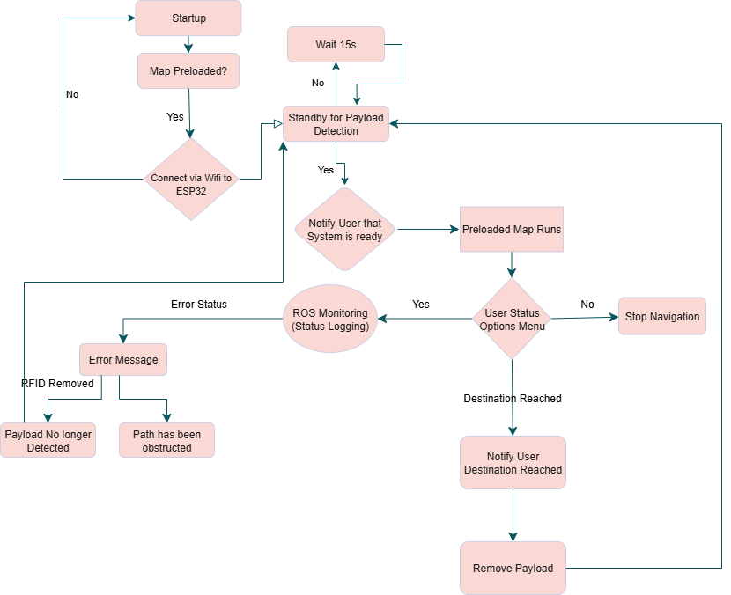
Software Design - Activity Flow Diagram

Slide 45
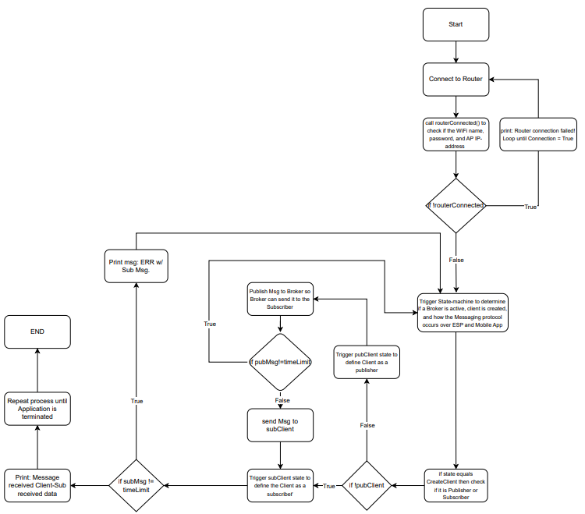
Software Design - Network Flow Diagram

Slide 46
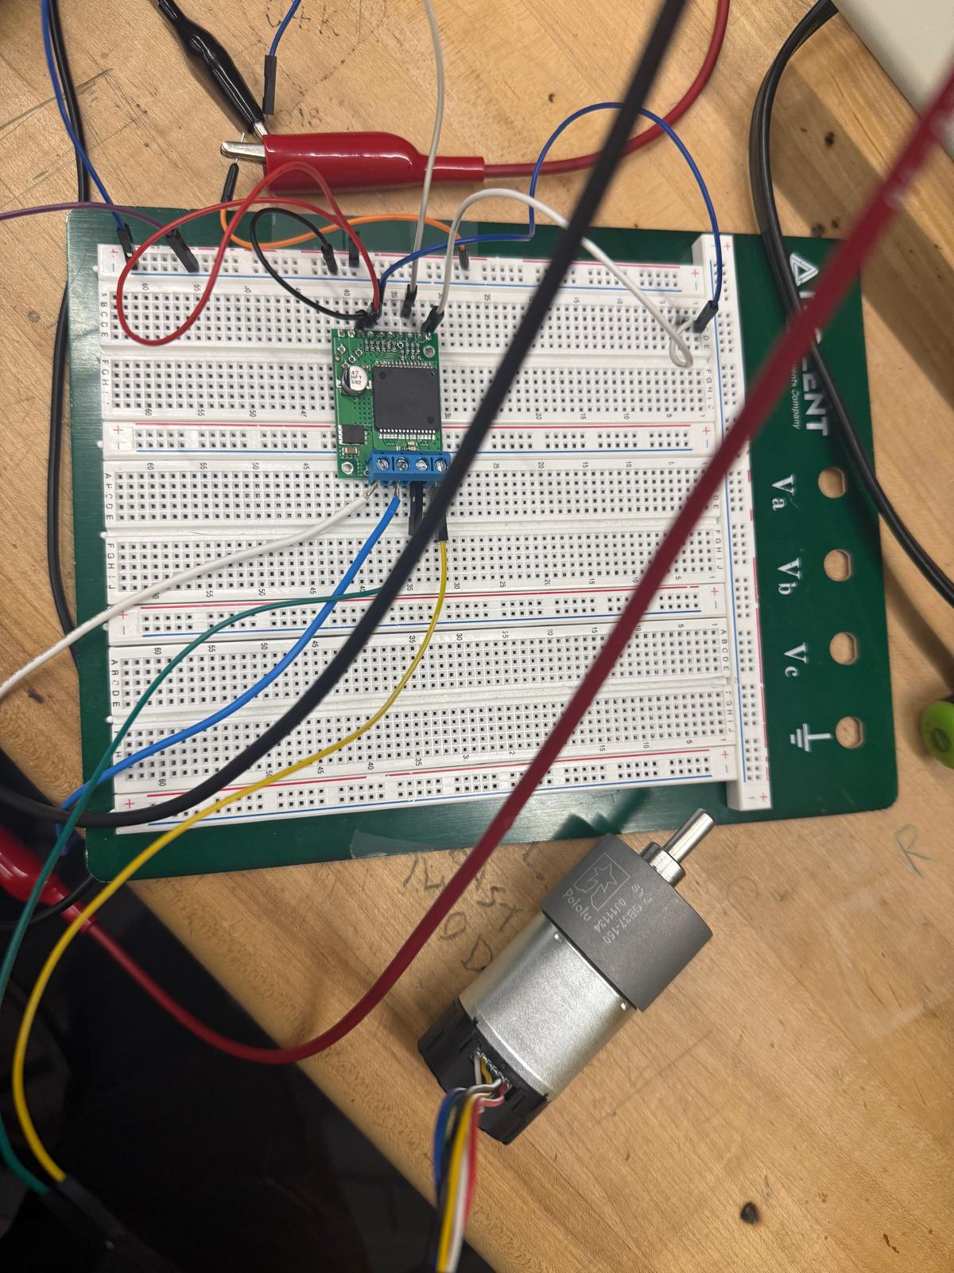
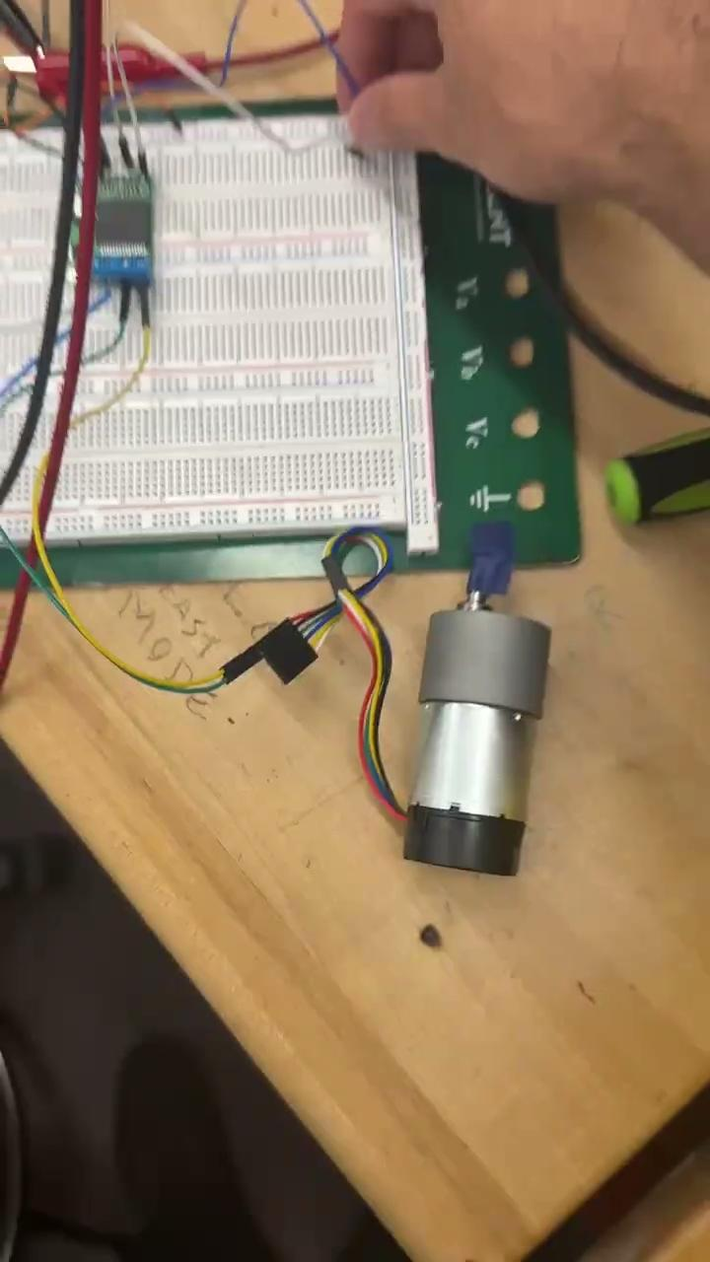
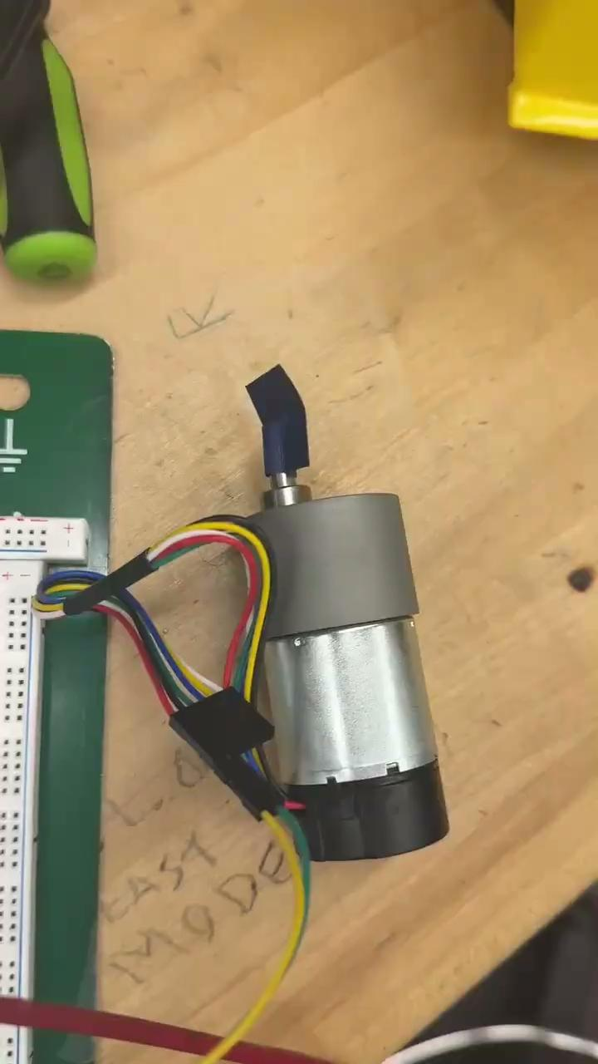
Prototyping and Testing - Motors

Slide 47
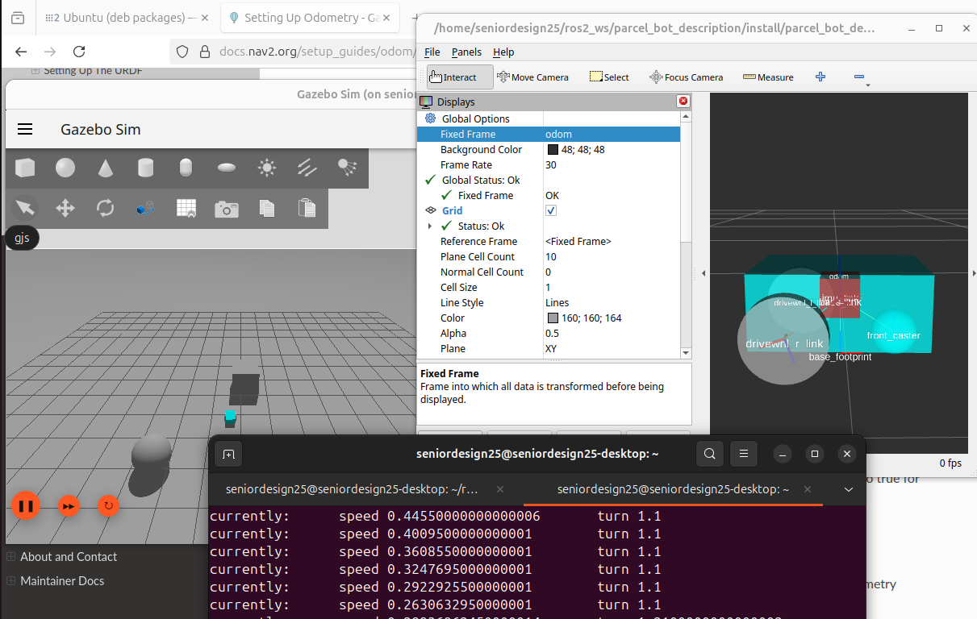
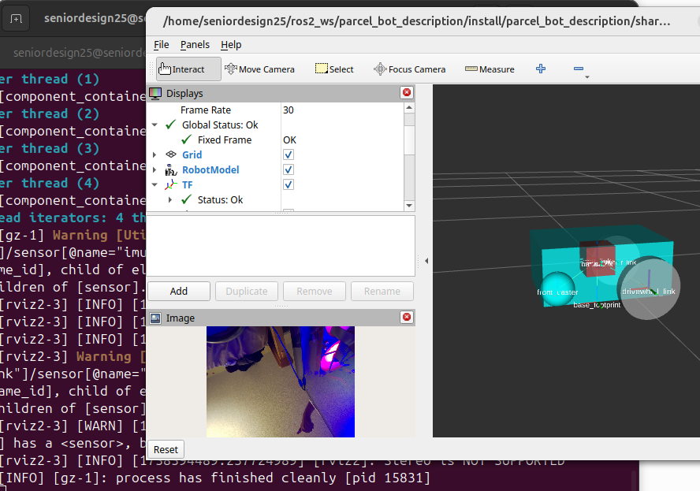
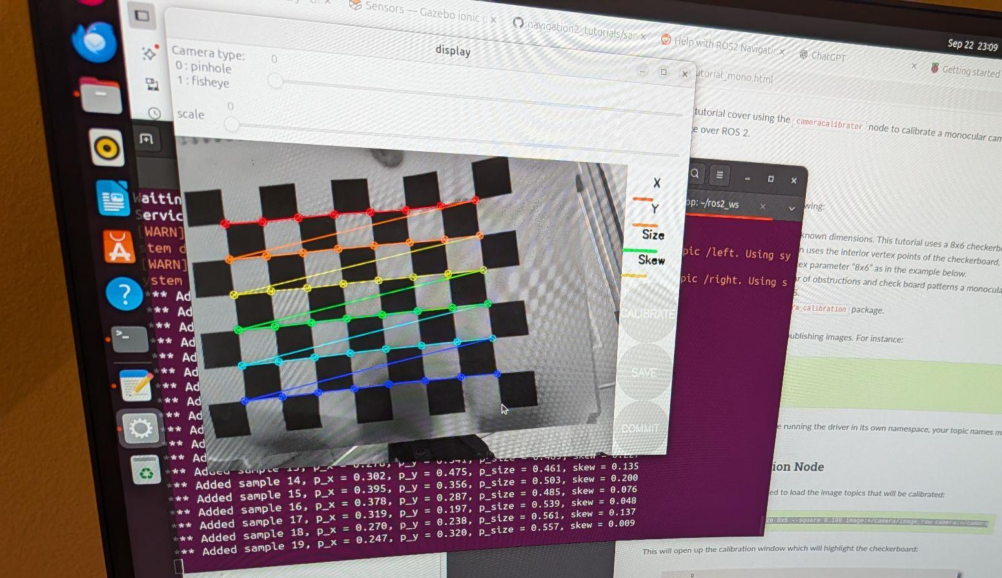
Prototyping and Testing - Camera/Robot Simulation

Slide 48
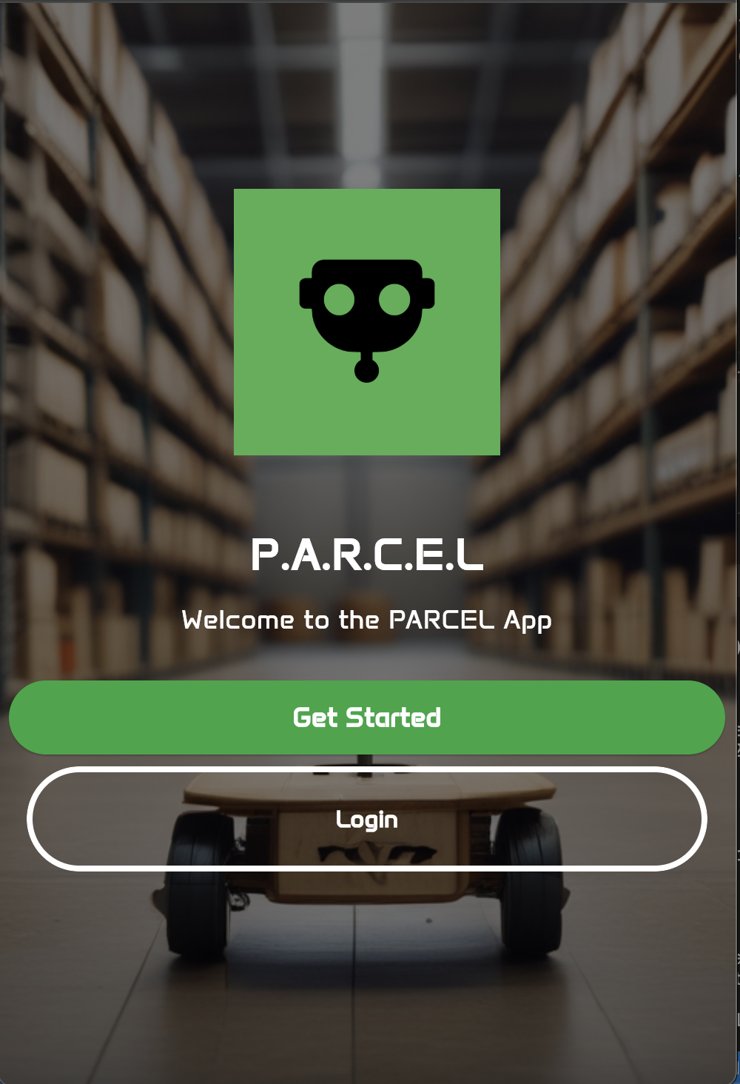
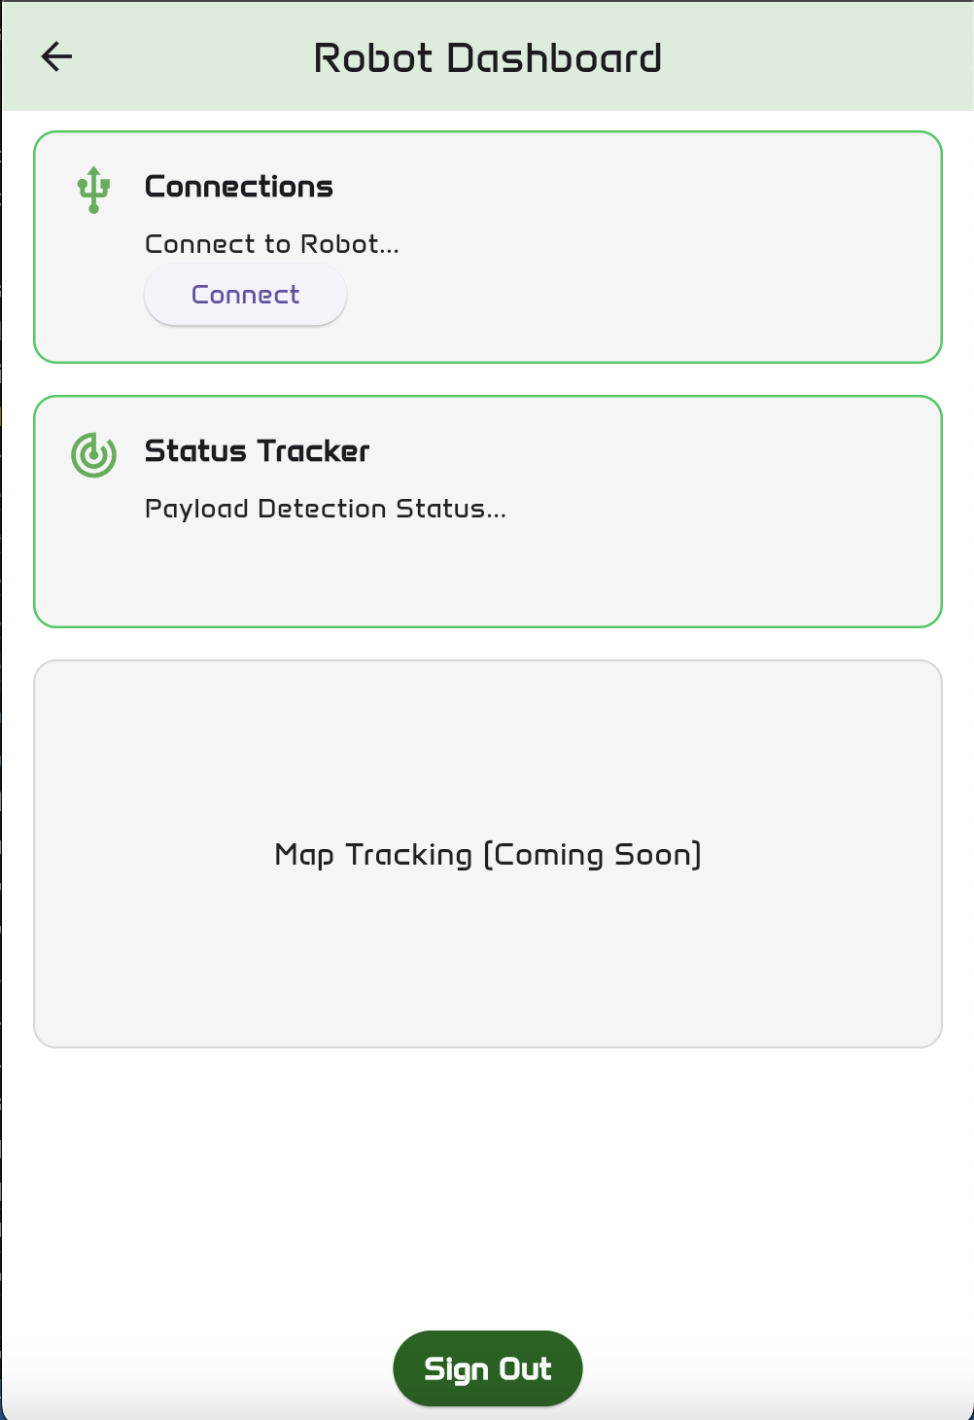
Prototyping and Testing - Mobile App

Slide 49
Administrative Content - Budget
System | Description | Estimated Cost
Power System | VR PCBs and batteries | $200
Electrical Hardware System | PCBs, sensors, components, and motors | $500
Mechanical Hardware System | Chassis, screws, mounts, and wheels | $75
Total |  | $775

Slide 50
Administrative Content - Work Distribution
Electrical Engineering | Responsibilities
Ibrahim Khater | PCB Design and Integration
 | Power management and distribution
 | PCB assembly
 | Chassis and mechanical design
Computer Engineering | Responsibilities
Riley Newport | MCU Software Development
 | MCU/Sensor Interfacing
 | MCU/Raspberry Pi Communication
 | Motor Control
Computer Engineering | Responsibilities
Melyia Ince-Ingram | Robot Operating System Set up
 | SLAM - Sensor Configuration
 | Camera Calibration
 | Robot Simulation
Computer Engineering | Responsibilities
Brandon Zabawa | Mobile App Dev.
 | Network Programming
 | Communication between MCU & App
 | SW verification

Slide 51
Progress and Plan for Completion
Progress
Research 100%
PCB & Parts Acquisition 75%
Prototyping & Testing 30%
Major Milestones and Plan
Verification and Testing of PCBs October 3rd
Construction of Robot Chassis October 10th
Hardware Integration October 10th
Software Development - App October 10th
Software Integration October 17th
Final Testing November 7th

Slide 52

Any questions?
Ask away!

